Slide 1
Saqib Gulam Hussain Shaikh
Financial Performance Analysis Report
Introduction:
Hi! I made this Finance Dashboard in Power BI with the Finance Excel Workbook provided by Unified Mentor. The goal of this Power BI project is to analyze financial performance across different countries, products, and time periods, using key financial metrics such as sales, profit, cost of goods sold (COGS), and discounts.
This study will help us get a clearer picture of short-term market trends and give useful insights into how these companies move together or differently in the stock market.
By the end of this project, we’ll have:
● Bar Charts showing the financial performance of different countries.
● Line Graphs visualizing the trend in sales and profit over time.
● Heat Maps to understand the impact of discount bands on sales.
● Scatter Plots to see the relationship between gross sales and discounts.
These visualizations will provide comprehensive insights into financial performance and profitability across different segments, countries, and time periods.

Slide 2
Problem Statement:
● The goal of this Power BI Dashboard Project is to analyze the financial
performance of a company using the provided Sample Data.
● To create a visually appealing dashboard that provides an overview of the
company's financial metrics enabling stakeholders to make informed business
decisions.
Sections in the Report:
Report has Multiple Section's from where you can manage the Data, Like :
● Report Data can be sliced by Segments, Country and Year to show Particular
Data.
● It has cards showing Total Units Sold, Total Gross Sale and Total Profit.
● It has a Clustered Bar Chart with Year on X-Axis and Profit on Y-Axis showing
Profit Quarterly.
● It has a Area Chart showing Months on X-Axis and Profit on Y-Axis
showing profit Monthly.
● And Other Charts like: (Sales and Profit by Country Combo col & line chart) (Total Sales And Total Profit By month Line chart) (Sum of Gross Sales, Sum of Discounts & Count of Country By product scatter chart) (Sales by Product and Discount Band Heat Map).
Report has been distributed into 3 pages: (Executive Dashboard Overview) gives the “CEO view”, (Sales & Profit Analysis) gives the “Sales Manager point of view”
& Lastly (Product & Discount Insights) that gives the “Product/Marketing view”.

Slide 3
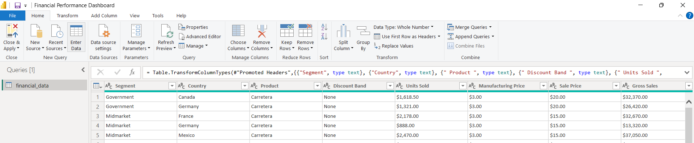
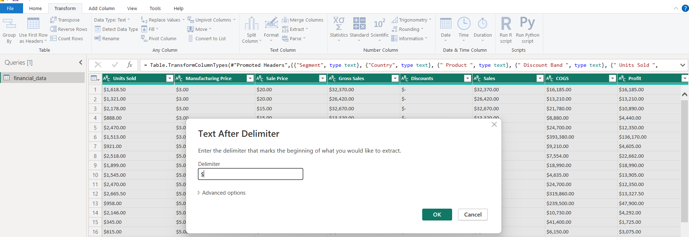
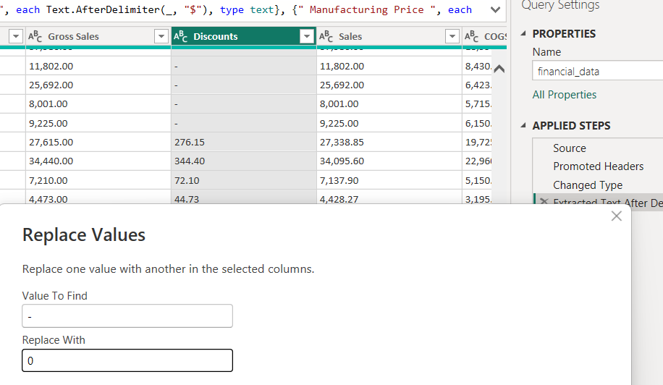
Task 1: Data Import and Preparation
1. Connect to Data: Importing Data
2. Ensure that the Date, Month Number, Month Name, and Year fields are
correctly formatted as dates.
After importing the dataset into Power Bl. As we can see some discrepancy in the data as: Columns like (unit sold, sales, Discounts, Profit) All are formatted as texts instead of whole number or currency and along with a $ character on the start, which will throw an error to change the data type. Let’s start cleaning the data by changing the data type and removing the $ character with the extract tool: Extracting texts after ($) delimiter, for all the columns altogether:
changing the data type to Whole Number.
Replacing (–) in the discount & Profit Col with a 0. To avoid error while changing the data type.

Slide 4
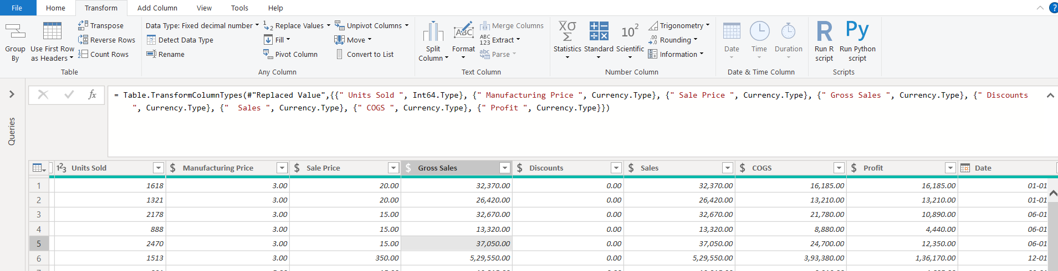
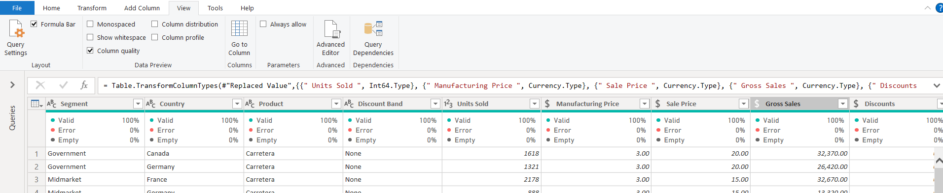
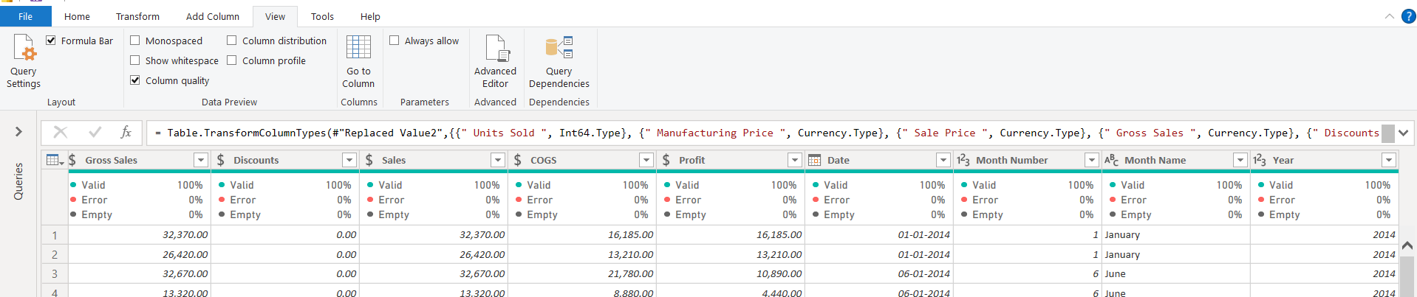
Final step of cleaning the data:
Changed the Data types of columns to Whole Number & Fixed Decimal Numbers
Profiling to ensure there are no error or empty cells in any columns.
And we are done with cleaning and preparing our Data ☺

Slide 5
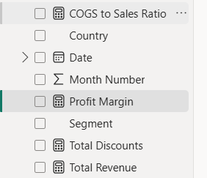
Creating Measures:
After cleaning the dataset. The next step as per the guide is to Create Calculated Fields:
We'll create some new measures for deeper analysis.
Profit Margin: To analyze profitability.
Profit Margin = DIVIDE(SUM(financial_data[ Profit ]), SUM(financial_data[ Sales ]))
Total Discounts: To calculate the total discount given.
Total Discounts = SUM(financial_data[Discounts])
Total Revenue (Gross Sales):
Total Revenue = SUM(SalesData[Gross Sales])
Cost-to-Sales Ratio (COGS to Sales):
COGS to Sales = SUM([COGS]) / SUM([Sales])
And we have our 4 new measures!

Slide 6
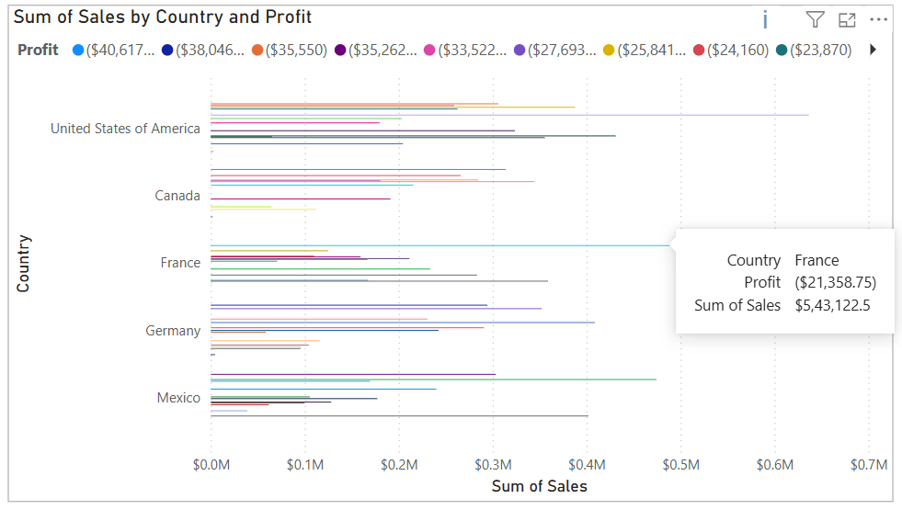
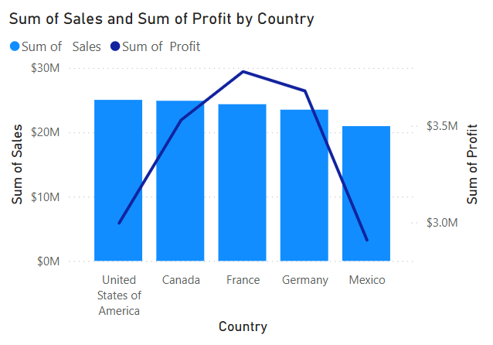
Task 2: Visualizations
a) Sales and Profit by Country (Bar Chart):
1. Drag Country to Columns.
2. Drag Sales to Rows.
3. Color by Profit: Drag Profit to the Color mark.
4. Use a Bar Chart to compare sales and profits across countries.
5. Add filters for Segment and Product to refine the analysis by these categories.
As the bar chart seems to be messy and hard to Analyze, Here’s an Alternative I came up with:
Combo Chart (Best for Sales vs Profit)
Changed the chart to Line and Clustered Column Chart.
Added Country on X-axis.
Added Sales in Column values.
& Profit in Line values. Now we can see bars for Sales and a line for Profit, as that is much easier to compare.

Slide 7
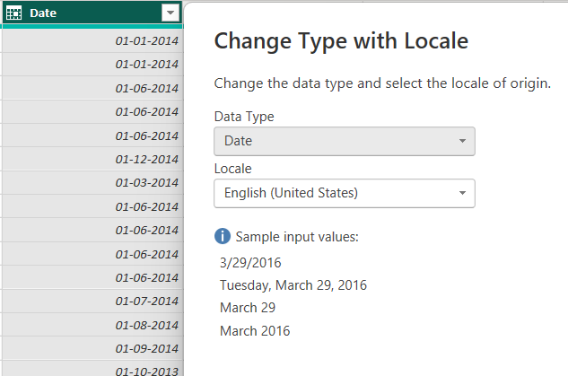
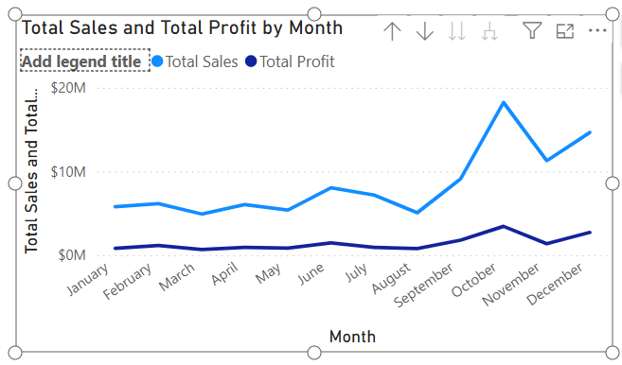
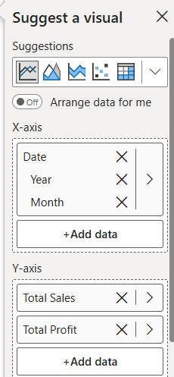
b. Sales and Profit Trend Over Time (Line Graph):
1. Drag Year to Columns.
2. Drag Sales and Profit to Rows.
3. Change the chart type to a Line Graph.
4. Add Month Name to the Columns for a more granular analysis.
5. Color by Segment to visualize trends for different business segments.
As we have data for 1st of every month, To avoid issue with the dates, I’ve changed the Type with Locale to US
Here I’ve added the Date to X axis & (Sales and Profit) Measures to Y axis
We can now view the Sales And Profit Comparison by Year or Month. However, When you put two measures (Total Sales & Total Profit) on the Y-axis in Power BI, it creates a combo line chart with multiple measures.
Hence, Power BI disables the Legend by category (Segment) because the legend is already being used to distinguish between the two measures (Sales vs Profit). So it won’t be possible to Color by Segment to visualize trends for different business segments in the same chart. Alternatively we can create a separate chart for Sales and Profit (by Segment).

Slide 8
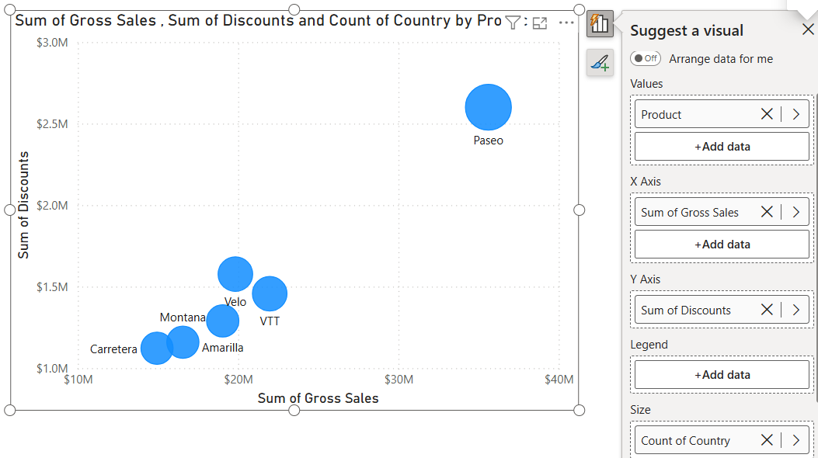
c. Gross Sales vs Discounts (Scatter Plot):
1. Drag Gross Sales to Columns.
2. Drag Discounts to Rows.
3. Change the chart to a Scatter Plot.
4. Use Size or Color to differentiate between Product or Country.
5. This allows you to see the relationship between discounts and gross sales.
Here, I’ve selected a Scatter Chart & added the Gross Sales to X axis & Discounts to the Y axis. For Bubbles Counts , I’ve added Products in the values (Carretera, Montana, Velo, Amarilla, VTT, Paseo).
And for Bubble size I’ve added Country to the size, This indicates how widely each product was sold.
From this chart, We can analyze that:
The bubbles generally move upward as Gross Sales increase, meaning products with higher sales also tend to have higher discounts.
Paseo stands out:
Very high Gross Sales (≈ $40M) and very high Discounts (≈ $3M).
It’s also sold in many countries (biggest bubble).
Suggests it’s a top seller but likely relies heavily on discounts to drive those sales.
VTT and Velo:
Mid-level sales (≈ $20M) with proportionally high discounts (~$1.5M).
Both also have good country coverage.
Carretera and Montana:
Much lower sales (< $15M) and lower discounts (~$1M).
Smaller bubbles → fewer countries.
These products seem less dependent on discounts.

Slide 9
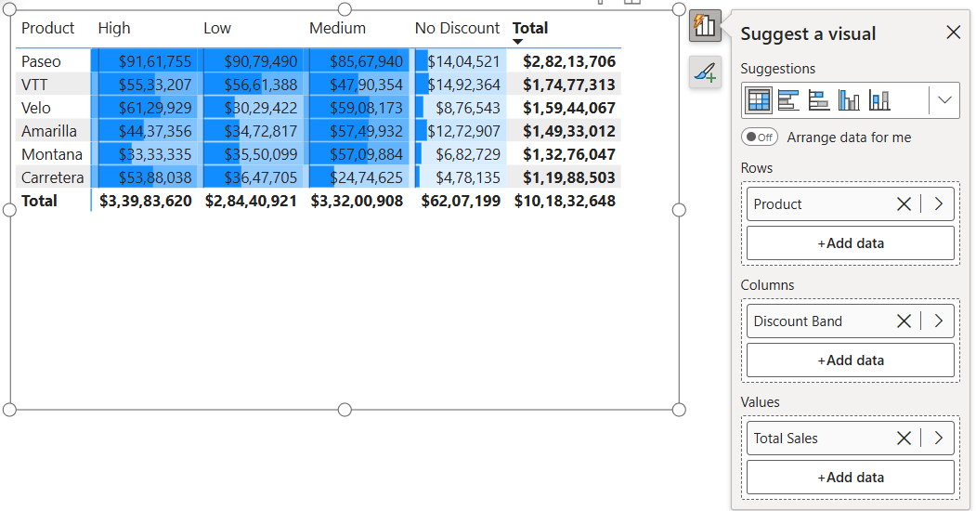
d. Sales by Product and Discount Band (Heat Map):
1. Drag Product to Rows.
2. Drag Discount Band to Columns.
3. Drag Sales to Color and change the visualization to Heat Map.
4. This shows how different discount bands affect product sales.
As Power BI doesn’t have a direct “Heat Map” option , Here, I’ve added a Matrix and added the Product to Rows, Discount Band to Columns & Total Sales Measure to the Values. And Formatted the Color of the Data Bars .
This matrix chart clearly shows that discounts have a strong affect on sales. Most products generates highest sales under the High and Medium discount bands, while the No Discount band contributes less than other. Among all products, Paseo records the highest sales across all discount levels, whereas Carretera and Montana remain the lowest performers. This indicates that offering discounts significantly boosts sales performance, and products like Paseo are more responsive to these discount strategies.

Slide 10
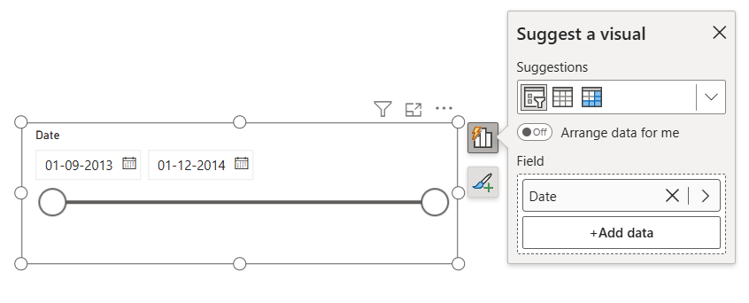
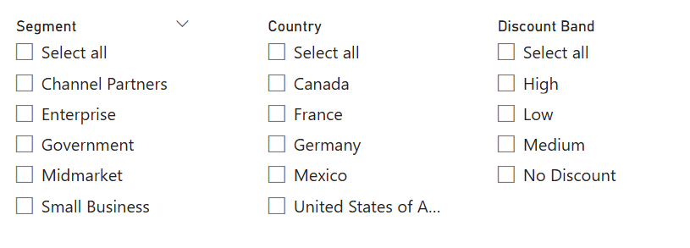
Task 3: Filters and Interactivity
1. Date Filter: Drag the Date field to the filter section. Provide a range slider so users can explore data from different periods.
2. Segment Filter: Drag Segment to the filter section to allow users to toggle between business segments (e.g., Consumer, Corporate, etc.).
3. Country Filter: Drag Country to Filters, and show the filter on the dashboard so users can focus on specific countries.
4. Profitability vs Discounts: Create an interactive filter to allow users to filter data by discount bands and analyze how they affect profitability.
Here I’ve created a new visual for a Slicer Filter for Dates.
Similarly, I’ve created the remaining filters for Segment, Country & Discount Bands with an option to multi select or single select or to select all to filer any charts on the page.

Slide 11
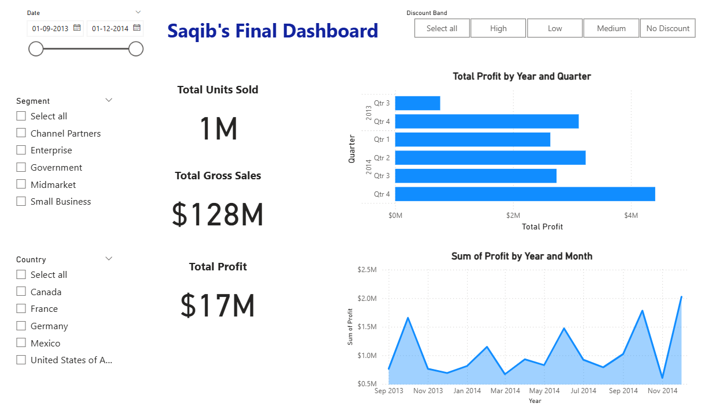
The Final Dashboard
Final Dashboard Consists of 3 Pages:
1: Executive Dashboard (Overview)
2: Sales & Profit Analysis
3: Product & Discount Insights
Task 4: Data Visualization and Dashboard Design
1: Executive Summary (Overview)
Visuals to include:
Cards: Total Units Sold, Total Gross Sales, Total Profit
Chart: Total Profit by Quarter (bar)
Chart: Total Profit by Month (area)
Slicers: Date, Segment, Country, Discount Band

Slide 12
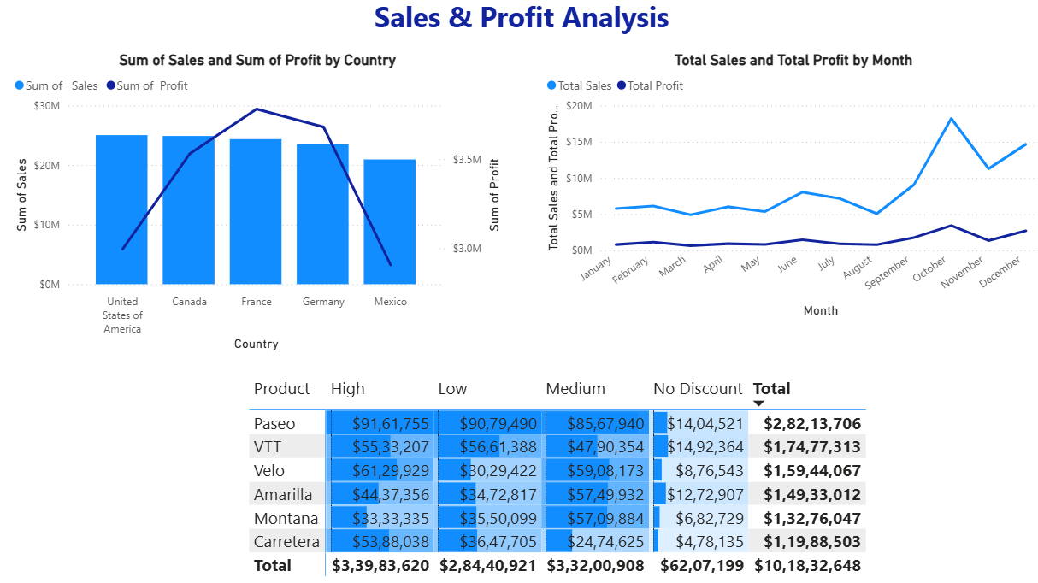
Page 2: Sales & Profit Analysis:
Visuals Include:
Combo Chart: Sales and Profit by Country (Column + Line)
Line Chart: Total Sales & Total Profit by Month (if not already on page 1, keep it here for detail view).
Heat Map: Sales by Product and Discount Band

Slide 13
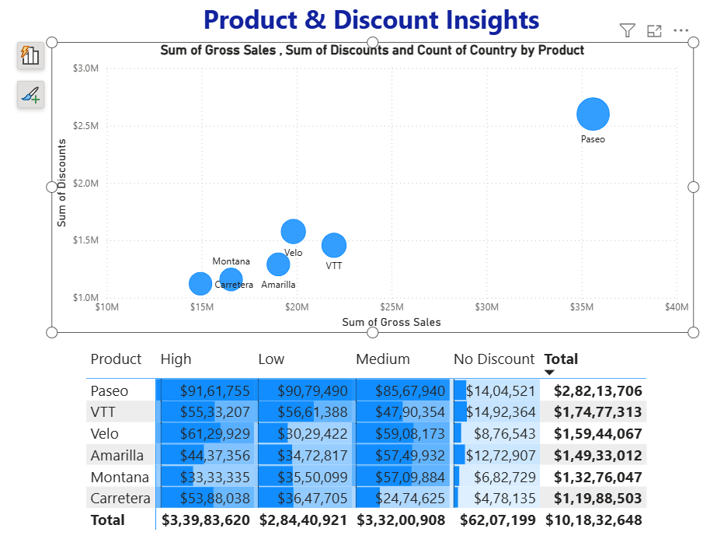
Page 3: Product & Discount Insights
Visuals to include:
Scatter Chart: Gross Sales vs Discounts vs Country by Product
Heat Map (if not on previous page): Sales by Product and Discount Band
Thank You

